Slide 1
Statistical Intervals for a Single Sample

Slide 2
Learning Objectives
After careful study of this chapter, you should be able to do the following:
1. Construct confidence intervals on the mean of a normal distribution, using normal distribution / t distribution method
2. Construct confidence intervals on the variance and standard deviation of a normal distribution
3. Construct confidence intervals on a population proportion
4. Use a general method for constructing an approximate confidence interval on a parameter

Slide 3
Introduction
How to compute I, u from sample data?
Population
unknown parameter θ
Random sample
l  θ  u,
where P(l  θ  u ) = 1 - α
l: lower-confidence limit (bound)
u: upper-confidence limit (bound)
1 − α: confidence coefficient, confidence level

Slide 4
Confidence Interval On The Mean Of A Normal Distribution, σ² Known
Problem. Suppose that X₁, X₂, … , X_{n} is a random sample from a normal distribution with unknown mean μ and known variance σ².
A confidence interval estimate for μ is an interval of the form l  μ  u
If P(l  μ  l) = 1 - α, (0  α  1), then
[l, u] is called confidence interval
1 - α is called the confidence coefficient, level of confidence, confidence level

Slide 5
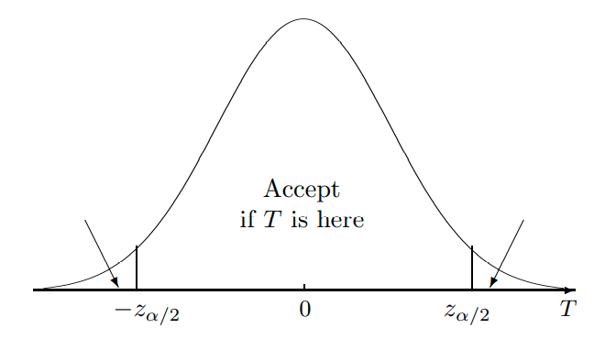
100(1 - α)% CI of A standard normal distribution
P(Z  z_{α}) = α
This area equals α/2
This area equals α/2
This area equals 1 - α
For a Standard Normal distribution
P(-z_{α/2}  Z  z_{α/2}) = 1 - α

Slide 6


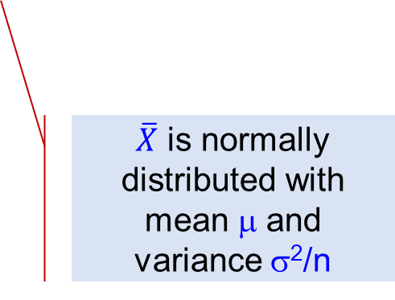
How to compute I, u from sample data?
Population
unknown mean μ
Random sample
L  μ  U,
where P(L  μ  U ) = 1 - α
$\overline{X}$ is normally distributed with mean μ and variance σ²/n

Slide 7
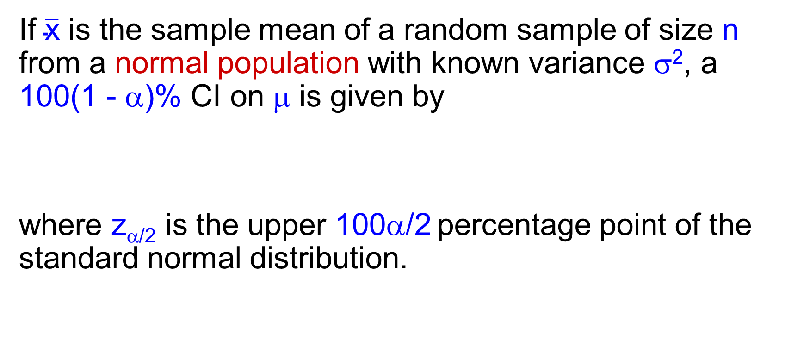
Confidence Interval on the Mean, Variance Known
If $\overline{\text{x}}$ is the sample mean of a random sample of size n from a normal population with known variance σ², a 100(1 - α)% CI on μ is given by
where z_{α/2} is the upper 100α/2 percentage point of the standard normal distribution.

Slide 8
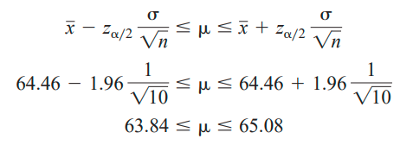
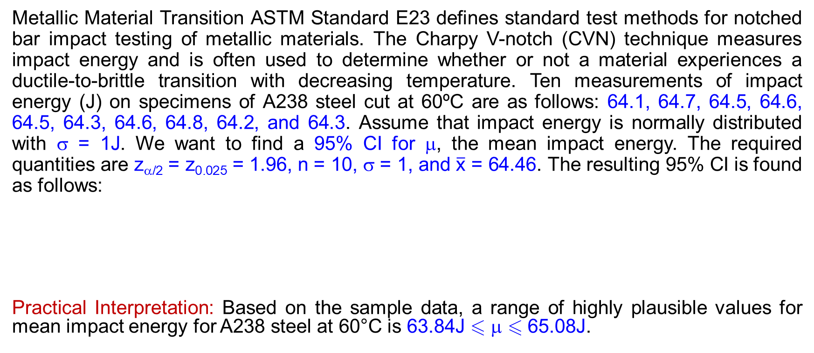
Confidence Interval on the Mean, Variance Known - Example
Metallic Material Transition ASTM Standard E23 defines standard test methods for notched bar impact testing of metallic materials. The Charpy V-notch (CVN) technique measures impact energy and is often used to determine whether or not a material experiences a ductile-to-brittle transition with decreasing temperature. Ten measurements of impact energy (J) on specimens of A238 steel cut at 60ºC are as follows: 64.1, 64.7, 64.5, 64.6, 64.5, 64.3, 64.6, 64.8, 64.2, and 64.3. Assume that impact energy is normally distributed with σ = 1J. We want to find a 95% CI for μ, the mean impact energy. The required quantities are z_{α/2} = z_{0.025} = 1.96, n = 10, σ = 1, and $\overline{\text{x}}$ = 64.46. The resulting 95% CI is found as follows:
Practical Interpretation: Based on the sample data, a range of highly plausible values for mean impact energy for A238 steel at 60°C is 63.84J  μ  65.08J.

Slide 9
Interpreting a Confidence Interval
If an infinite number of random samples are collected and a 100(1 - α)% confidence interval for is computed from each sample, 100(1 - α)% of these intervals will contain the true value of μ.
We don’t know if the statement is true for this specific sample, but the method used to obtain the interval [l, u] yields correct statements 100(1 - α)% of the time.

Slide 10
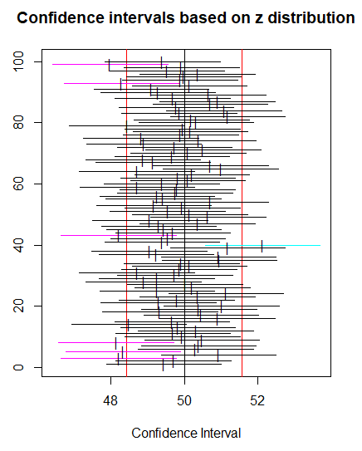
Simulated confidence intervals
100 samples of size 25 were generated from a norm(mean = 50, sd = 4) distribution, and each sample was used to find a 95% confidence interval for the population mean. The 100 confidence intervals are represented above by horizontal lines, and the respective sample means are denoted by vertical slashes. Confidence intervals that “cover” the true mean µ = 50 are plotted in black; those that fail to cover are plotted in a lighter color. In the plot we see that 7 of the simulated intervals out of the 100 failed to cover µ = 50, which is a success rate of 93%. If the number of generated samples were to increase from 100 to 1000 to 10000, . . . , then we would expect our success rate to approach the exact value of 95%.
Notes:
# Use R
library(TeachingDemos)
ci.examp(mean.sim = 50, sd = 4, n = 25, reps = 000, conf.level = 0.95)

Slide 11
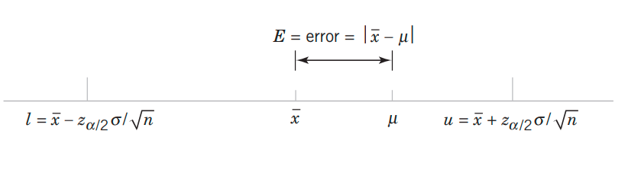


Choice of sample size
From the 100(1 - α)% CI
We have E = error = | $\overline{\text{x}}$ - μ |  z_{α/2} $\frac{σ}{\sqrt{\text{n}}}$
Choose n such that E = z_{α/2} $\frac{σ}{\sqrt{\text{n}}}$

Slide 12

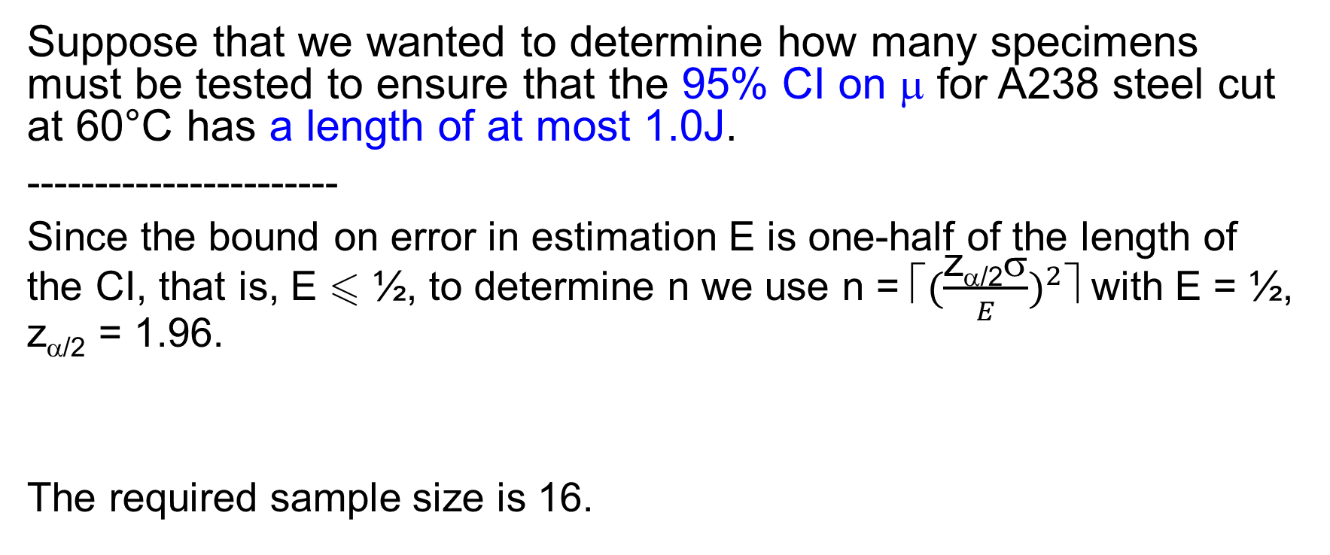
Choice of sample size - Example
Suppose that we wanted to determine how many specimens must be tested to ensure that the 95% CI on μ for A238 steel cut at 60°C has a length of at most 1.0J.
-----------------------
Since the bound on error in estimation E is one-half of the length of the CI, that is, E  ½, to determine n we use n = ⎡${(\frac{\text{z}\text{α/2}σ}{E})}^{2}$⎤ with E = ½, z_{α/2} = 1.96.
The required sample size is 16.

Slide 13
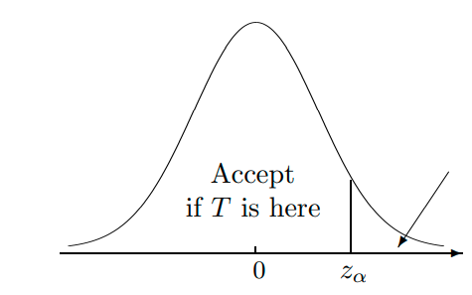
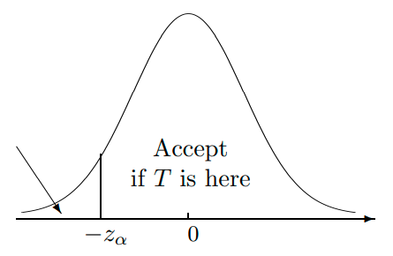
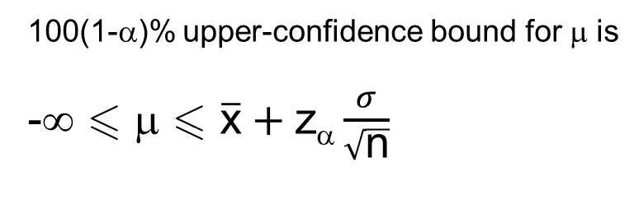
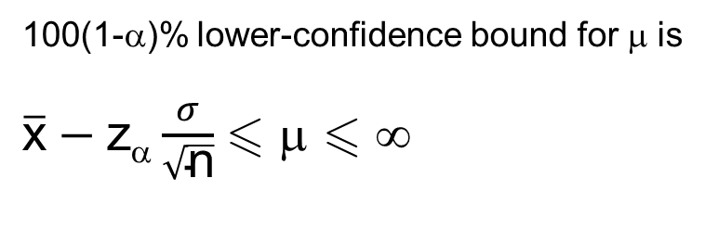
One-Sided Confidence Bounds
This area equals α
This area equals 1 - α
This area equals 1 - α
100(1-α)% lower-confidence bound for μ is
$\overline{\text{x}}−$z_{α} $\frac{σ}{\sqrt{\text{n}}}$ μ  ∞
100(1-α)% upper-confidence bound for μ is
-∞  μ  $\overline{\text{x}}+$z_{α} $\frac{σ}{\sqrt{\text{n}}}$

Slide 14
Confidence Interval on the Mean Unknown σ² ⬅ Large sample size
What if σ is unknown? We instead use the interval
where s (used to estimate σ) is the sample standard deviation and n is large enough
What if n is small?
s
s

Slide 15
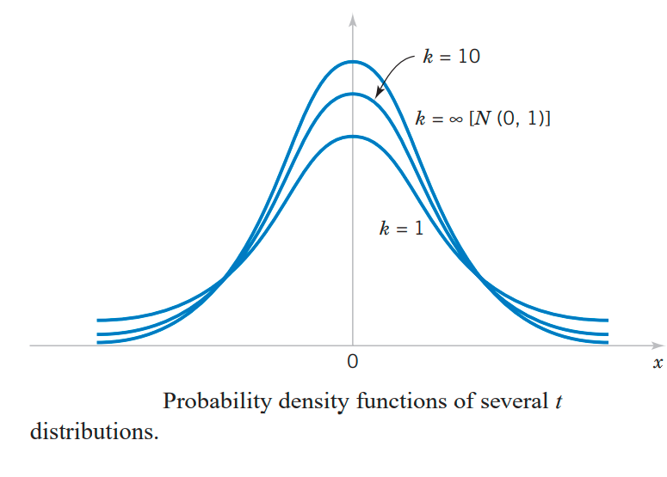

t distribution
Let X₁, X₂, … , X_{n} be a random sample from a normal distribution with unknown mean μ and unknown variance σ². The random variable
T = $\frac{\overline{X}−μ}{S/\sqrt{n}}$
has a t distribution
with n - 1 degrees of freedom.
Probability density functions of several t distributions

Slide 16
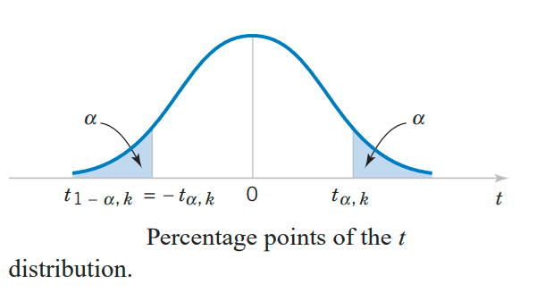
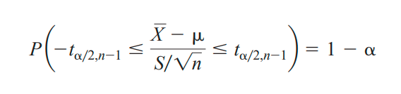
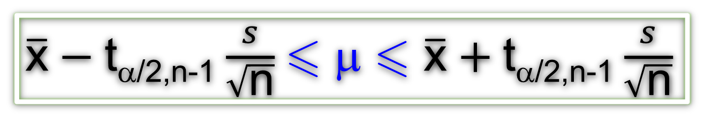
t Confidence Interval on μ
Percentage points of the t distribution
$\overline{\text{x}}−$t_{α/2,n-1} $\frac{s}{\sqrt{\text{n}}}$ μ  $\overline{\text{x}}+$t_{α/2,n-1} $\frac{s}{\sqrt{\text{n}}}$
Remark. One-sided confidence bounds on the mean are found by replacing t_{α/2,n-1} with t_{α,n-1}.

Slide 17
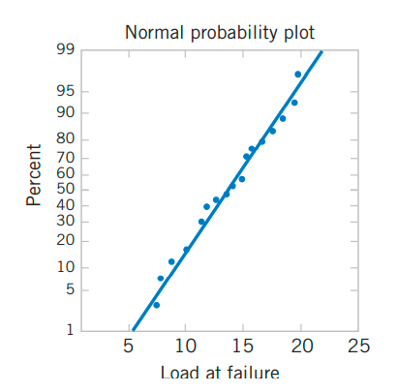
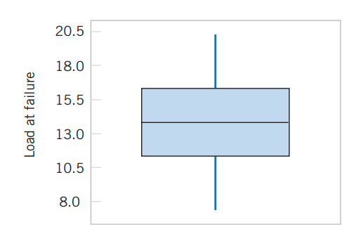

t Confidence Interval on μ - Example
An article in the journal Materials Engineering (1989, Vol. II, No. 4, pp. 275–281) describes the results of tensile adhesion tests on 22 U-700 alloy specimens. The load at specimen failure is as follows (in megapascals):
19.8 10.1 14.9 7.5 15.4 15.4
15.4 18.5 7.9 12.7 11.9
11.4 11.4 14.1 17.6 16.7
15.8 19.5 8.8 13.6 11.9 11.4
The sample mean is $\overline{\text{x}}$ = 13.71, and the sample standard deviation is s = 3.55.
We want to find a 95% CI on μ. Since n = 22, we have n - 1 = 21 degrees of freedom for t, so t_{0.025,21} = 2.080.
$\overline{\text{x}}−$t_{α/2,n-1} $\frac{s}{\sqrt{\text{n}}}$ μ  $\overline{\text{x}}+$t_{α/2,n-1} $\frac{s}{\sqrt{\text{n}}}$ ➔ 12.14  μ  15.28

Slide 18
t Confidence Interval on μ - Example
12.14  μ  15.28
Practical Interpretation: The CI is fairly wide because there is a lot of variability in the tensile adhesion test measurements. A larger sample size would have led to a shorter interval.

Slide 19
One-Sided Confidence Bounds
This area equals α
This area equals 1 - α
This area equals 1 - α
100(1-α)% lower-confidence bound for μ is
$\overline{\text{x}}−$z_{α} $\frac{σ}{\sqrt{\text{n}}}$ μ  ∞
100(1-α)% upper-confidence bound for μ is
-∞  μ  $\overline{\text{x}}+$z_{α} $\frac{σ}{\sqrt{\text{n}}}$

Slide 20
Choice of sample size
From the 100(1 - α)% CI
We have E = error = | $\overline{\text{x}}$ - μ |  z_{α/2} $\frac{σ}{\sqrt{\text{n}}}$
Choose n such that E = z_{α/2} $\frac{σ}{\sqrt{\text{n}}}$

Slide 21

Choice of sample size - Example
Suppose that we wanted to determine how many specimens must be tested to ensure that the 95% CI on μ for A238 steel cut at 60°C has a length of at most 1.0J.
-----------------------
Since the bound on error in estimation E is one-half of the length of the CI, that is, E  ½, to determine n we use n = ⎡${(\frac{\text{z}\text{α/2}σ}{E})}^{2}$⎤ with E = ½, z_{α/2} = 1.96.
The required sample size is 16.

Slide 22
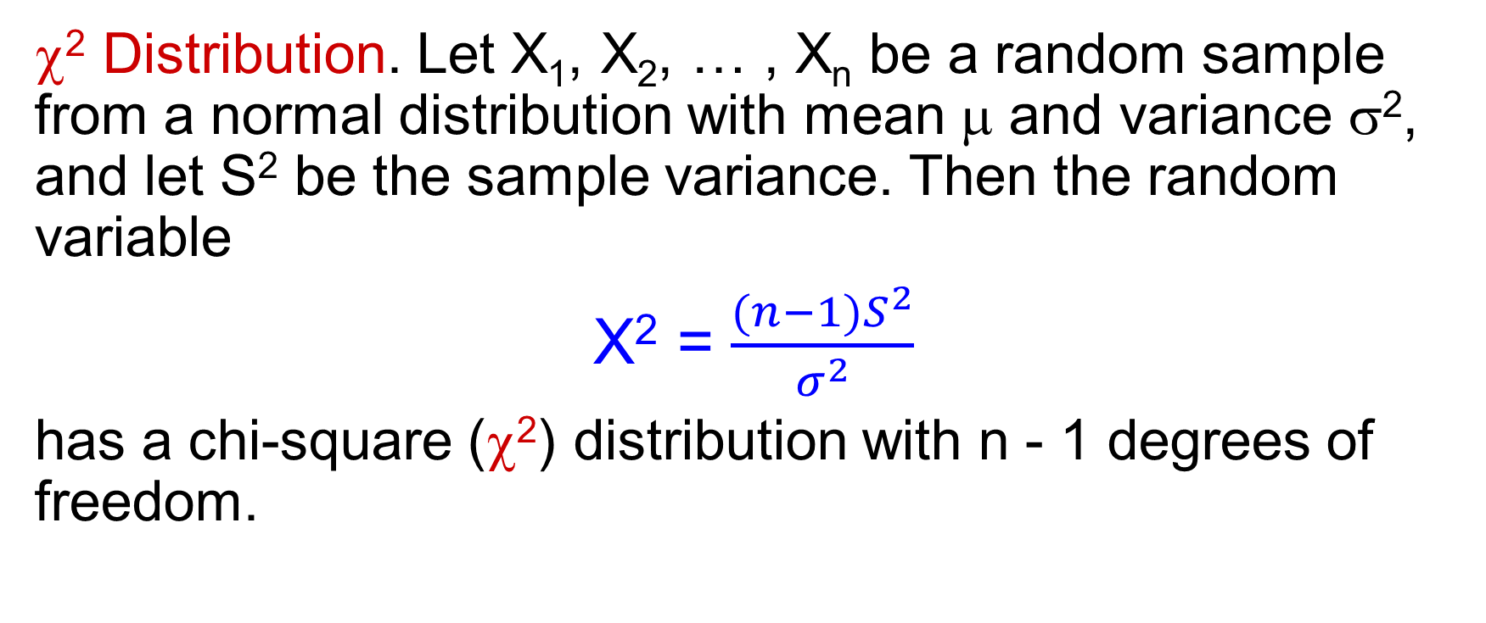
Confidence Interval for σ² of a Normal Distribution
χ² Distribution. Let X₁, X₂, … , X_{n} be a random sample from a normal distribution with mean μ and variance σ², and let S² be the sample variance. Then the random variable
X² = $\frac{(n−1)S^{2}}{σ^{2}}$
has a chi-square (χ²) distribution with n - 1 degrees of freedom.

Slide 23
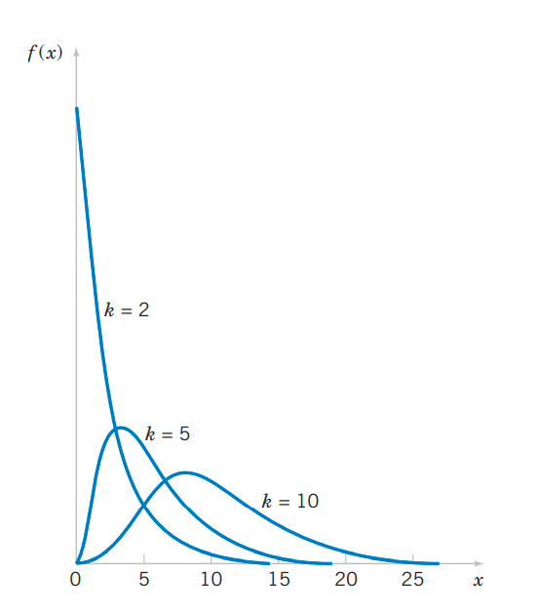
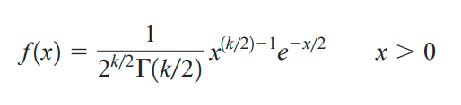
χ² distributions
mean = k
variance = 2k
Pdf of several χ² distributions.
➔ skewed to the right

Slide 24
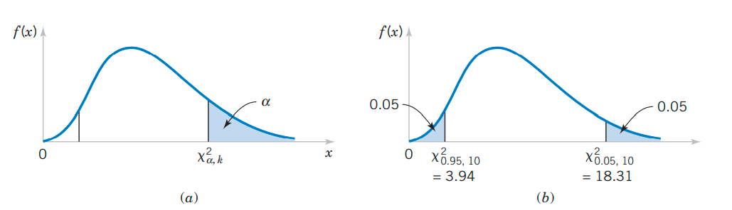
Percentage point of the χ² distribution.
The percentage point χ²_{α,k}.
The upper percentage point χ²_{0.05,10} = 18.31 and the lower percentage point χ²_{0.95,10} = 3.94

Slide 25

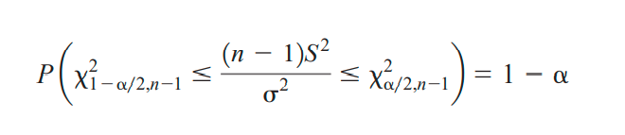
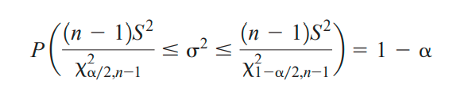
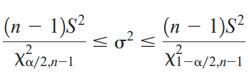
Confidence Interval on the Variance σ²
If s² is the sample variance from a random sample of n observations from a normal distribution with unknown variance σ², then a 100(1 - α)% CI on σ² is

Slide 26
Challenge
Find the One-Sided Confidence Bounds on the Variance

Slide 27
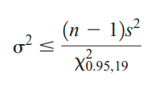
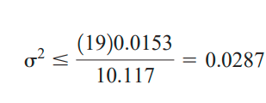

CI on the Variance σ² - Example
An automatic filling machine is used to fill bottles with liquid detergent. A random sample of 20 bottles results in a sample variance of fill volume of s² 0.0153 (fluid ounce)². If the variance of fill volume is too large, an unacceptable proportion of bottles will be under- or overfilled. We will assume that the fill volume is approximately normally distributed. A 95% upper confidence bound is
Practical Interpretation: At the 95% level of confidence, the data indicate that the process standard deviation could be as large as 0.17 fluid ounce. The process engineer or manager now needs to determine if a standard deviation this large could lead to an operational problem with under-or over filled bottles.

Slide 28
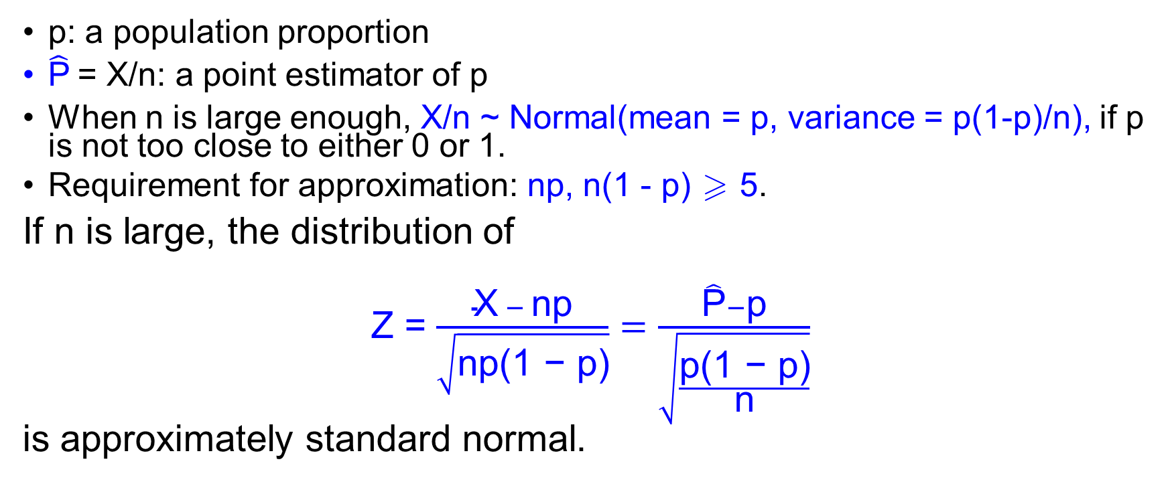
Normal Approximation for a Binomial Proportion
p: a population proportion
$\hat{\text{P}}$= X/n: a point estimator of p
When n is large enough, X/n ~ Normal(mean = p, variance = p(1-p)/n), if p is not too close to either 0 or 1.
Requirement for approximation: np, n(1 - p)  5.
If n is large, the distribution of
Z = $\frac{\text{X} − \text{np}}{\sqrt{\text{np}\text{(1 − }\text{p}\text{)}}}=\frac{\hat{\text{P}}−\text{p}}{\sqrt{\frac{\text{p}\text{(1 − }\text{p}\text{)}}{\text{n}}}}$
is approximately standard normal.

Slide 29
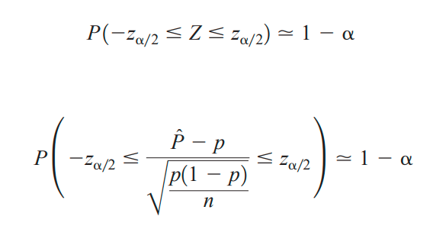
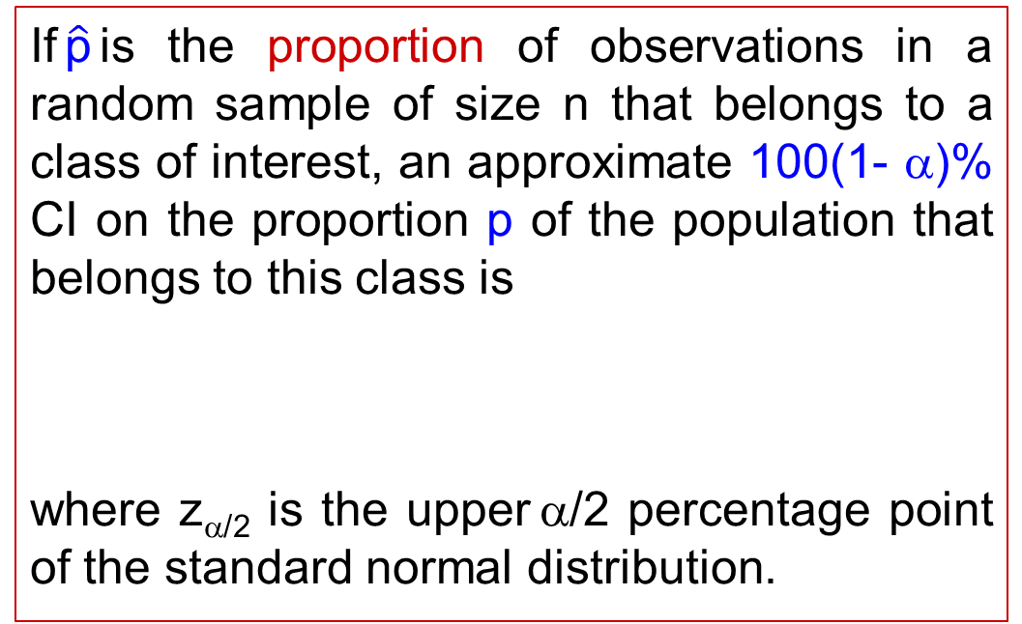
Approximate Confidence Interval on a Binomial Proportion
If$\hat{\text{p}}$is the proportion of observations in a random sample of size n that belongs to a class of interest, an approximate 100(1- α)% CI on the proportion p of the population that belongs to this class is
where z_{α/2} is the upper α/2 percentage point of the standard normal distribution.

Slide 30
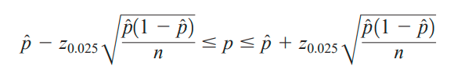

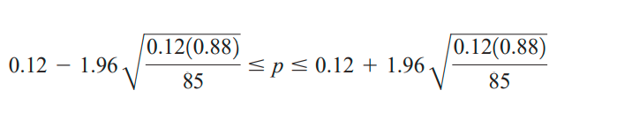

Approximate Confidence Interval on a Binomial Proportion - Example
In a random sample of 85 automobile engine crankshaft bearings,10 have a surface finish that is rougher than the specifications allow. Therefore, a point estimate of the proportion of bearings in the population that exceeds the roughness specification is $\hat{\text{p}}$= x/n = 10/85 = 0.12. A 95% two-sided confidence interval for p is

Slide 31
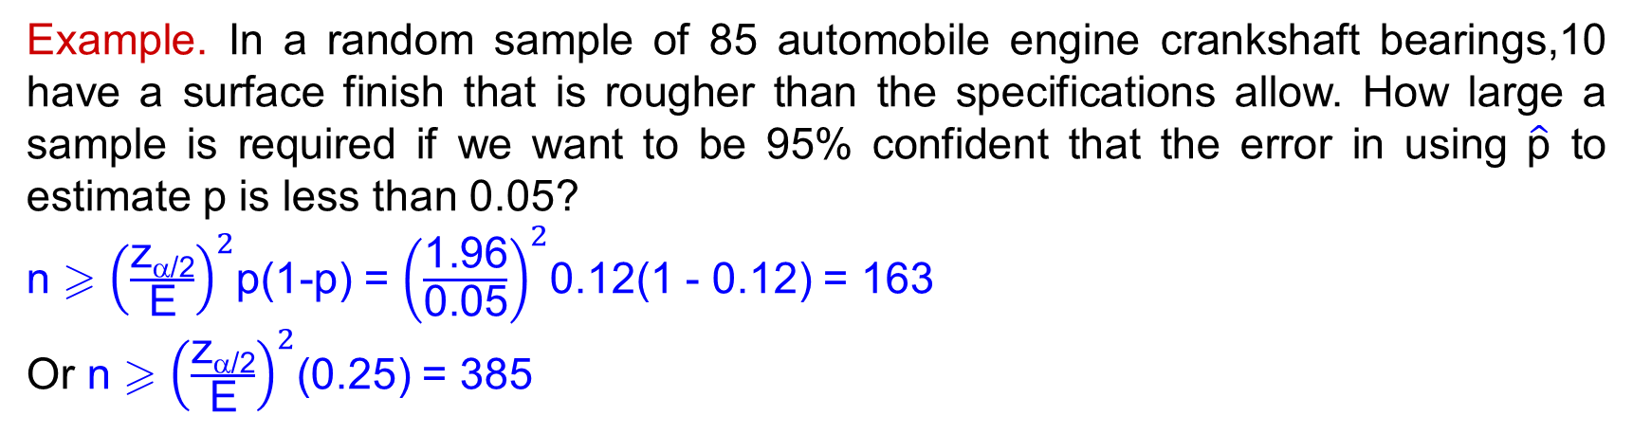

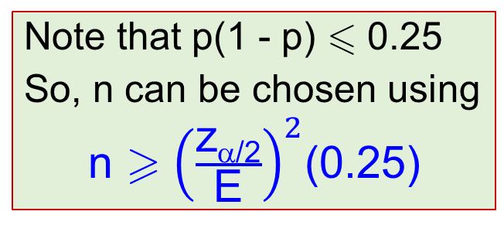
Choice of Sample Size
Error = E := |p - $\hat{\text{P}}$|
E  z_{α/2}$\sqrt{\text{p}\text{(1−}\text{p}\text{)/}\text{n}}$
 n  ${\left(\frac{\text{z}\text{}\text{/}\text{2}}{\text{E}}\right)}^{2}$p(1-p)
(In practice, use $\hat{\text{p}}$ as an estimate of p in this formula)
Note that p(1 - p)  0.25
So, n can be chosen using
n  ${\left(\frac{\text{z}\text{α}\text{/}\text{2}}{\text{E}}\right)}^{2}$(0.25)
Example. In a random sample of 85 automobile engine crankshaft bearings,10 have a surface finish that is rougher than the specifications allow. How large a sample is required if we want to be 95% confident that the error in using $\hat{\text{p}}$ to estimate p is less than 0.05?
n  ${\left(\frac{\text{z}\text{α}\text{/}\text{2}}{\text{E}}\right)}^{2}$p(1-p) = ${\left(\frac{\text{1.96}}{\text{0.05}}\right)}^{2}$0.12(1 - 0.12) = 163
Or n  ${\left(\frac{\text{z}\text{α}\text{/}\text{2}}{\text{E}}\right)}^{2}$(0.25) = 385
Practical Interpretation: if we have information concerning the value of p, we could use a smaller sample

Slide 32
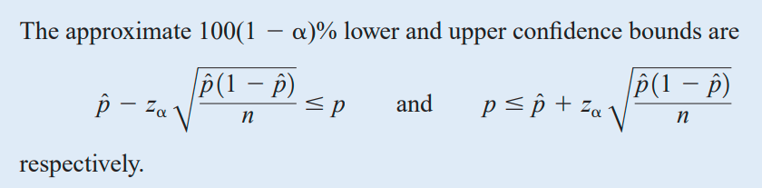
One-Sided Confidence Bounds

Slide 33
Summary
CONFIDENCE INTERVAL ON THE MEAN OF A NORMAL DISTRIBUTION, VARIANCE KNOWN
CONFIDENCE INTERVAL ON THE MEAN OF A NORMAL DISTRIBUTION, VARIANCE UNKNOWN
CONFIDENCE INTERVAL ON THE VARIANCE AND STANDARD DEVIATION OF A NORMAL DISTRIBUTION
LARGE-SAMPLE CONFIDENCE INTERVAL FOR A POPULATION PROPORTION

Slide 34
(3x + 17) mod 26 + 46
(5x + 17) mod 26 + 46
(7x + 17) mod 26 + 46

